Slide 1

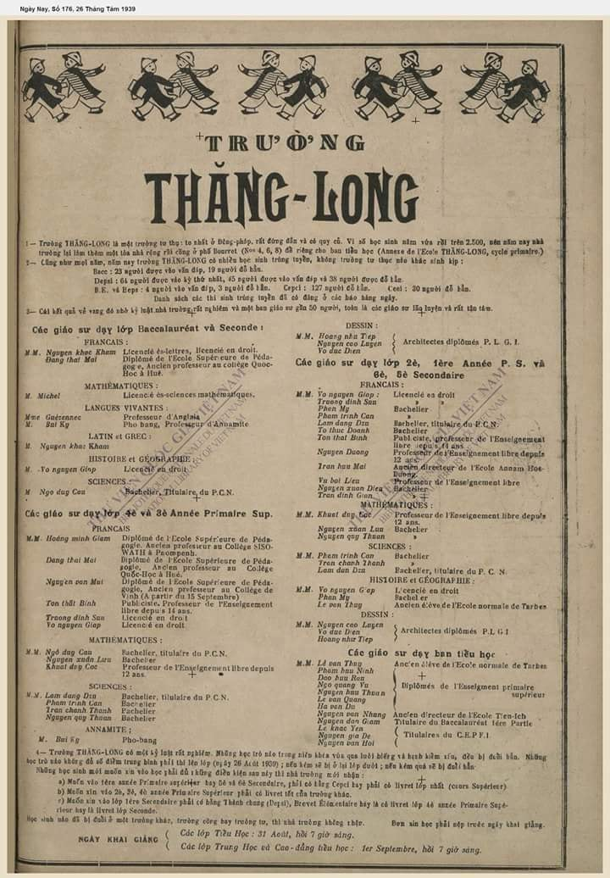

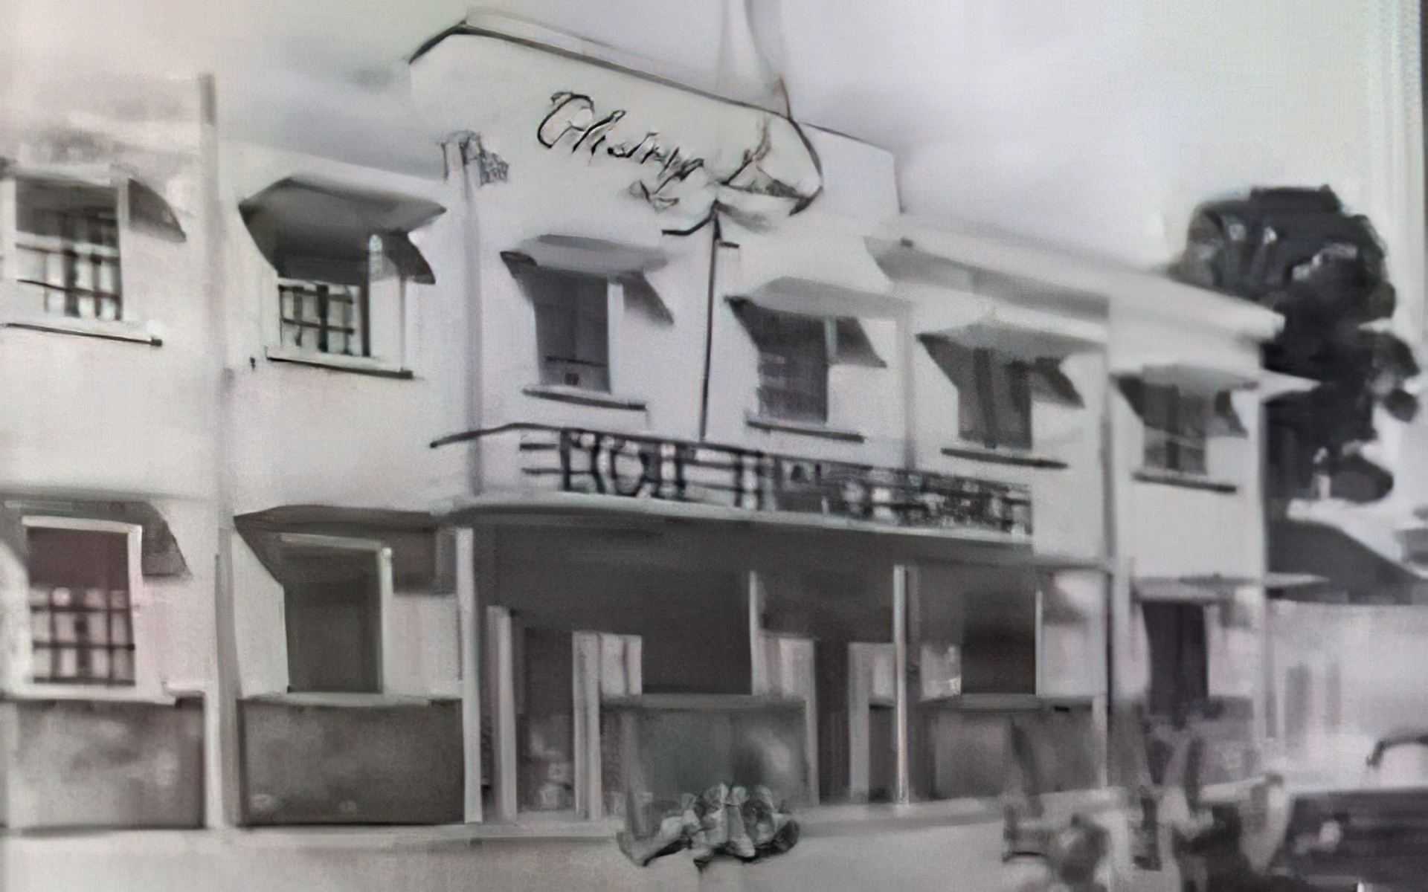
He (Vo NGUYEN GIAP) is not only
a historian, but he is also
a passionate lawyer, always defending
the legitimacy of history.
Bui Diem, one of Vo Nguyen Giap's students

